Slide 1
Mechanism
Basic Tools and Supply Chain
Notes:
Main Title Page

Slide 2
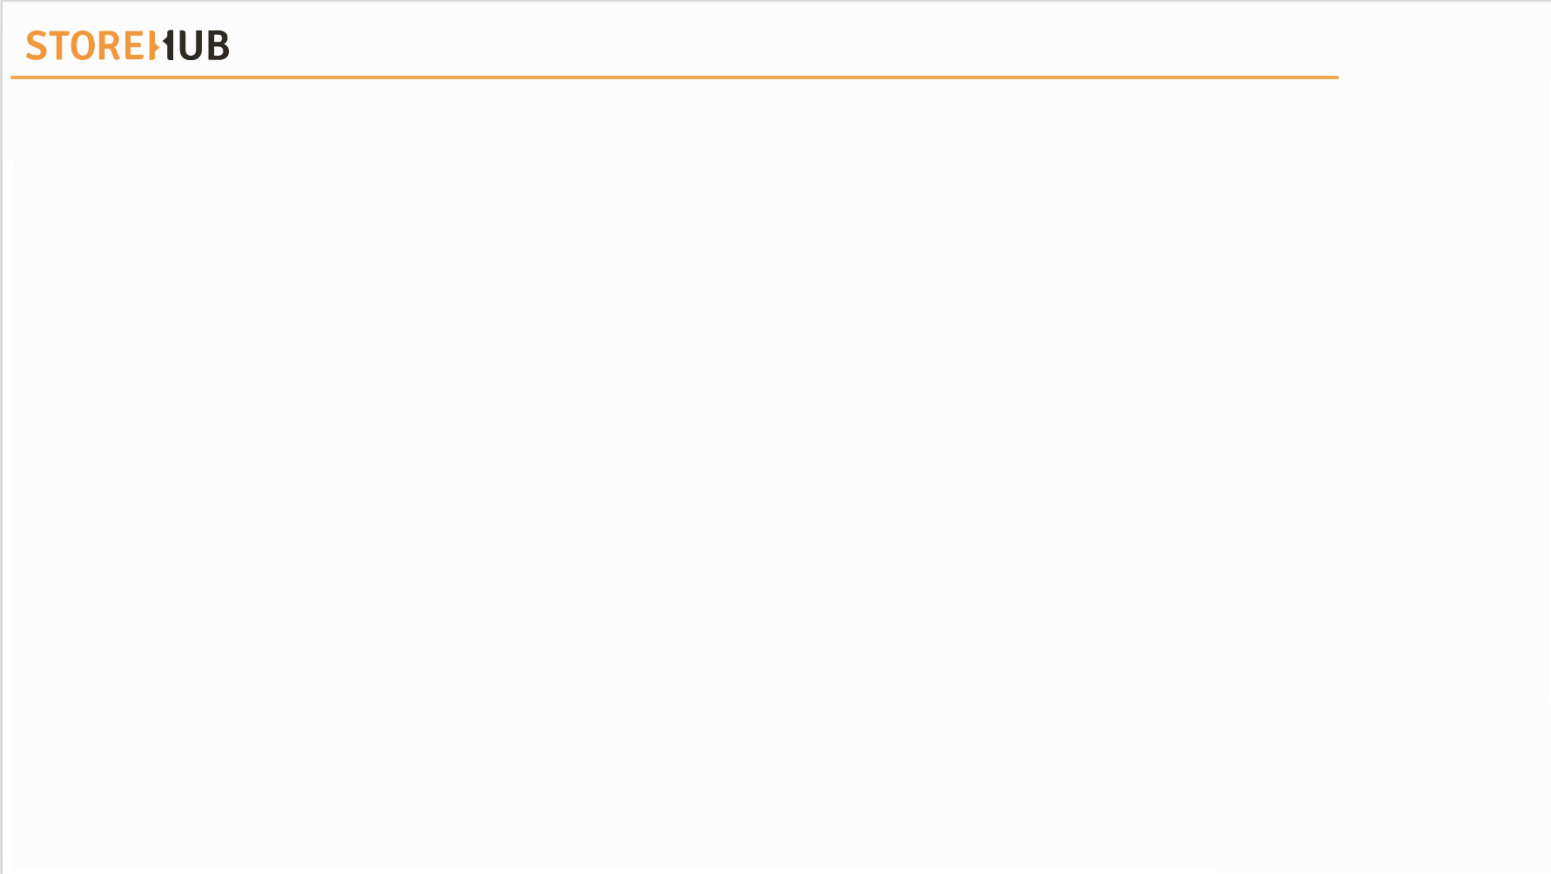



| Mechanism
Overview
Tools
Supply Chain

Slide 3
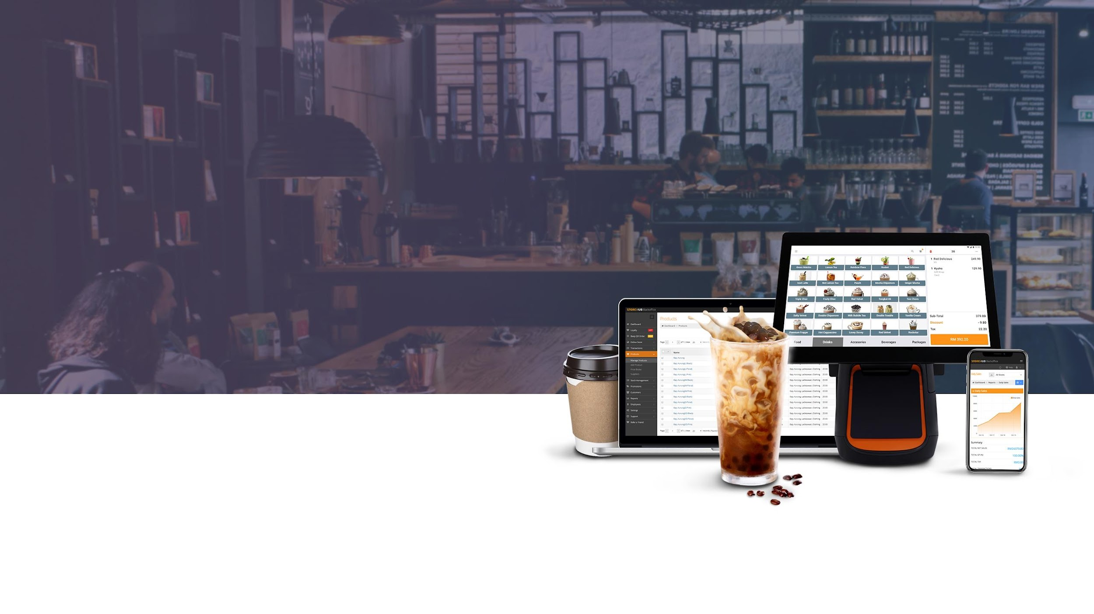
Tools

Slide 4







| Mechanism
Main Tools
Internal
KB
Library
Internal
Support
Tool

Slide 5

[ Team Using : All ]

Slide 6
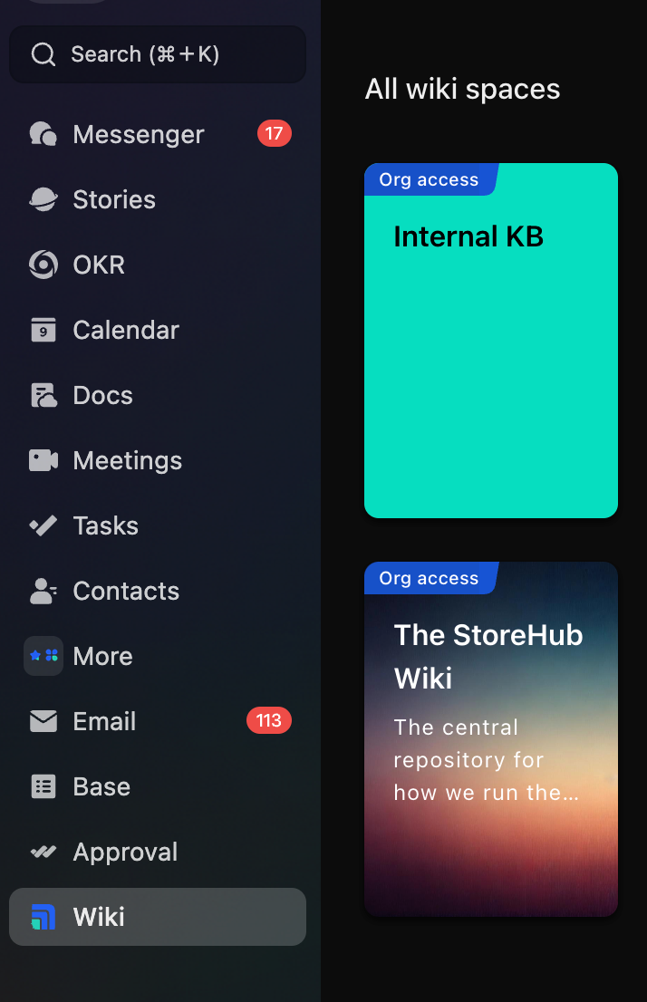
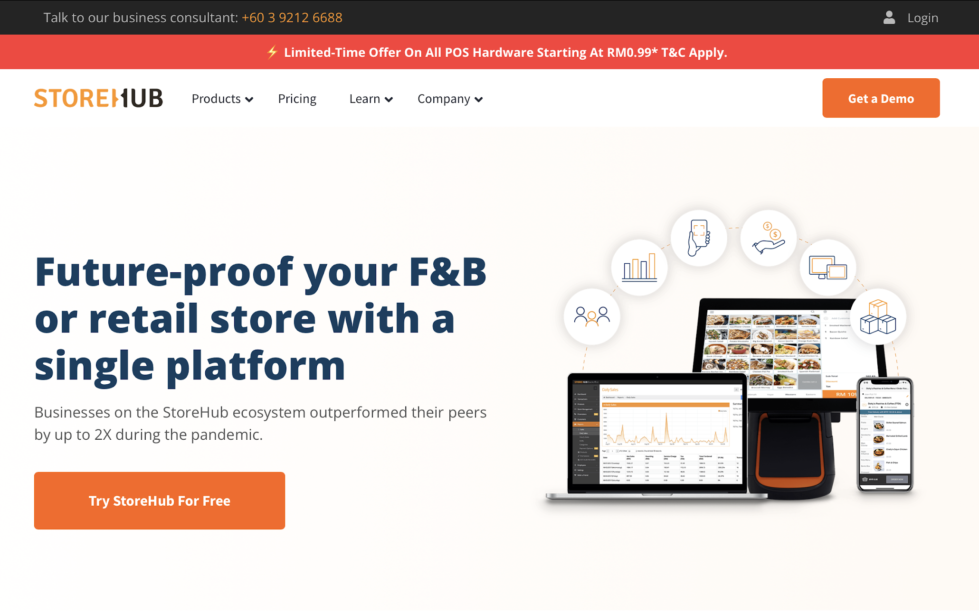

Knowledge Base
Introduction
Internal KB Library
Available at https://www.storehub.com/
Available at Lark Wiki
KB = Knowledge Base

Slide 7
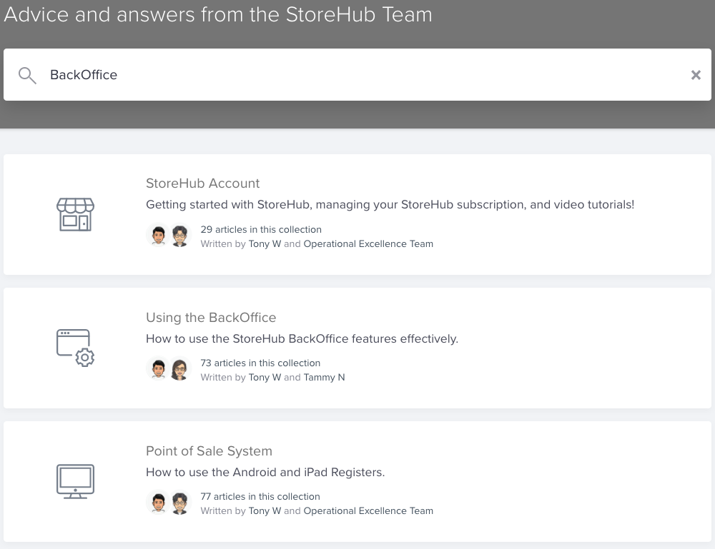
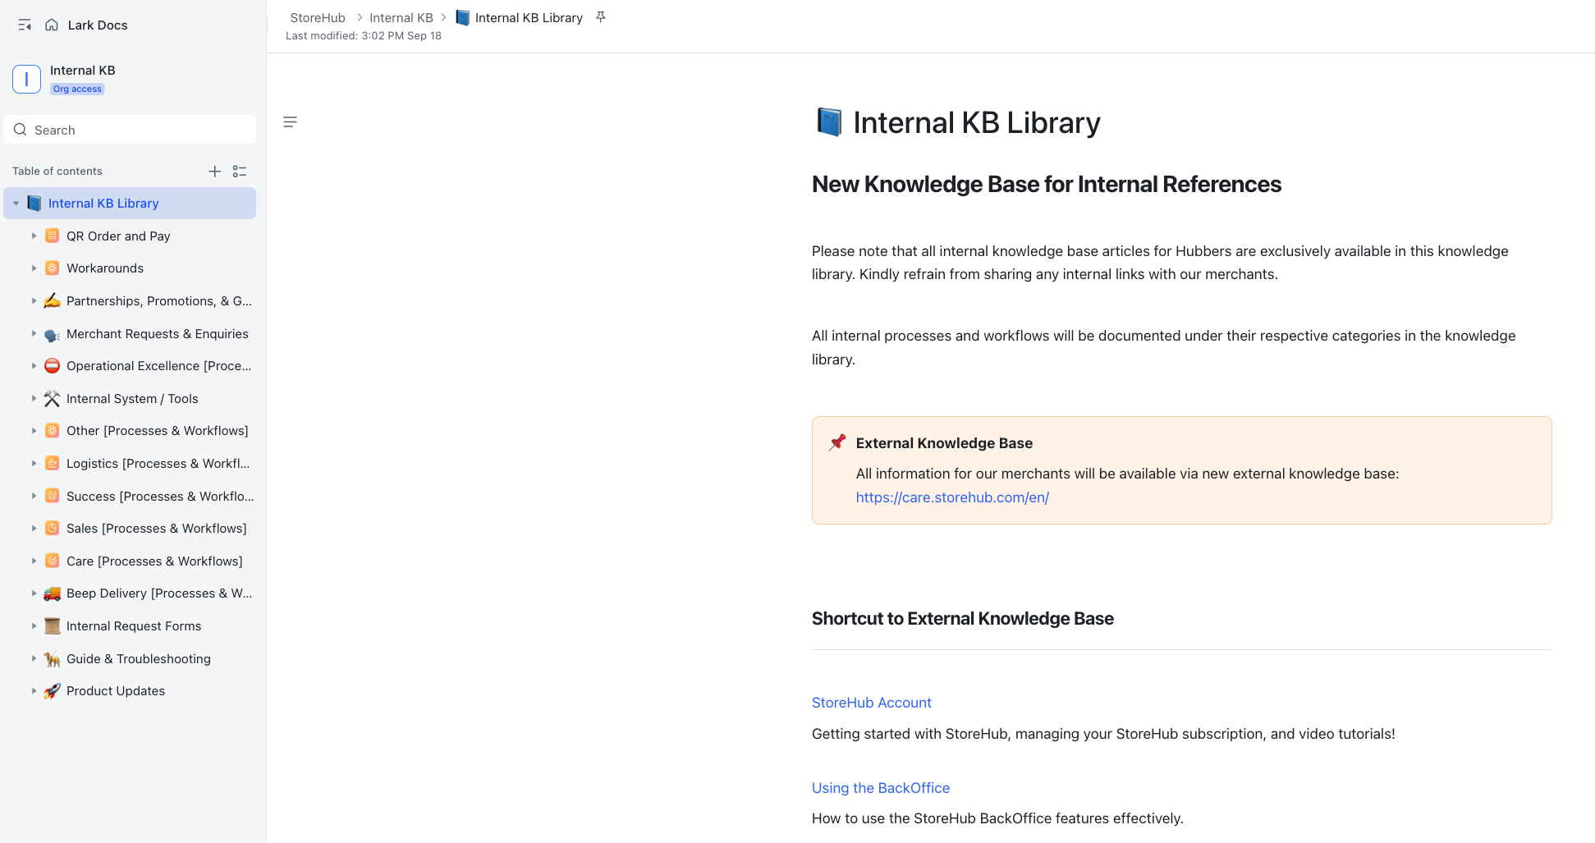
Knowledge Base
Navigation
Internal KB Library
Search Box
Search Box
Categories
Categories
KB = Knowledge Base

Slide 8
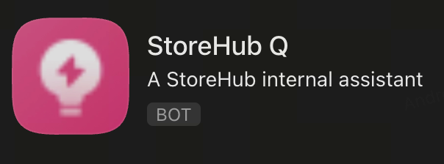
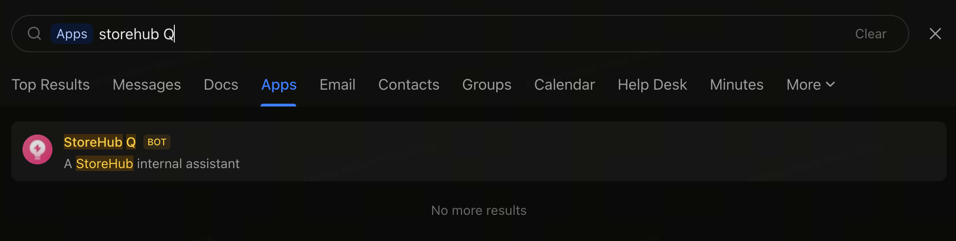
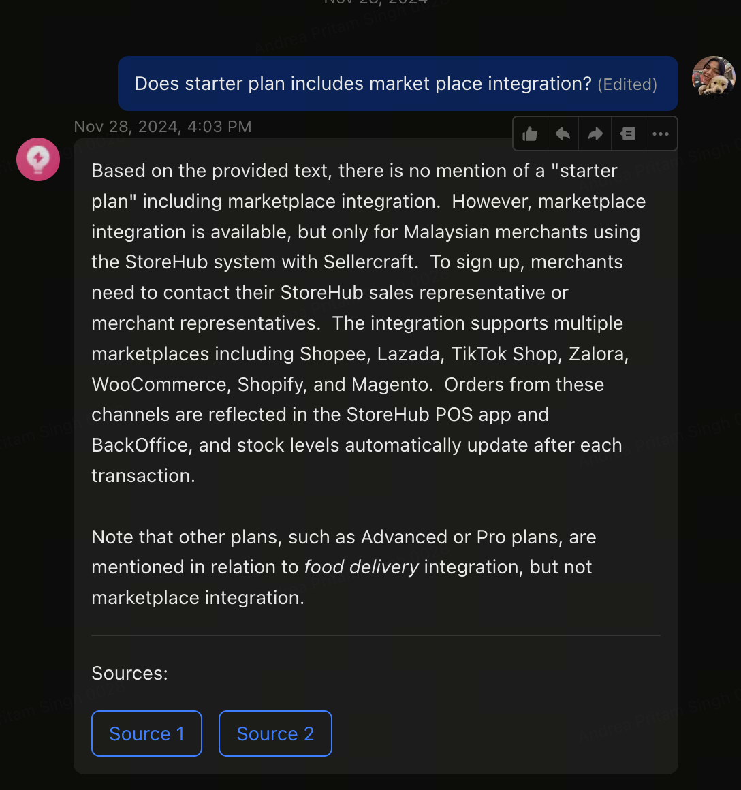
Knowledge Base
Navigation
Search for StoreHub Q on Lark
Have a question about StoreHub? Just ask StoreHub Q for answers!
What is StoreHub Q?
StoreHub Q is an AI-powered assistant designed to gather information from StoreHub’s resources, helping you provide accurate and efficient answers.
KB = Knowledge Base

Slide 9

IST – Internal Support Tool
[ Team Using : Beep / Fleet / Care/ Onboarding ]
Notes:
Change slide

Slide 10

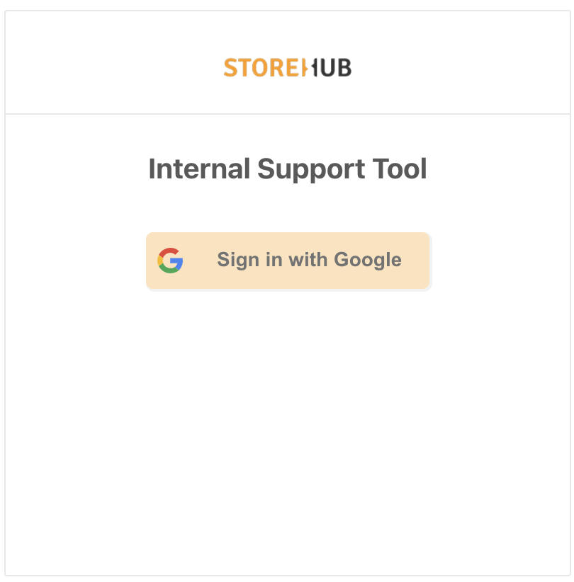

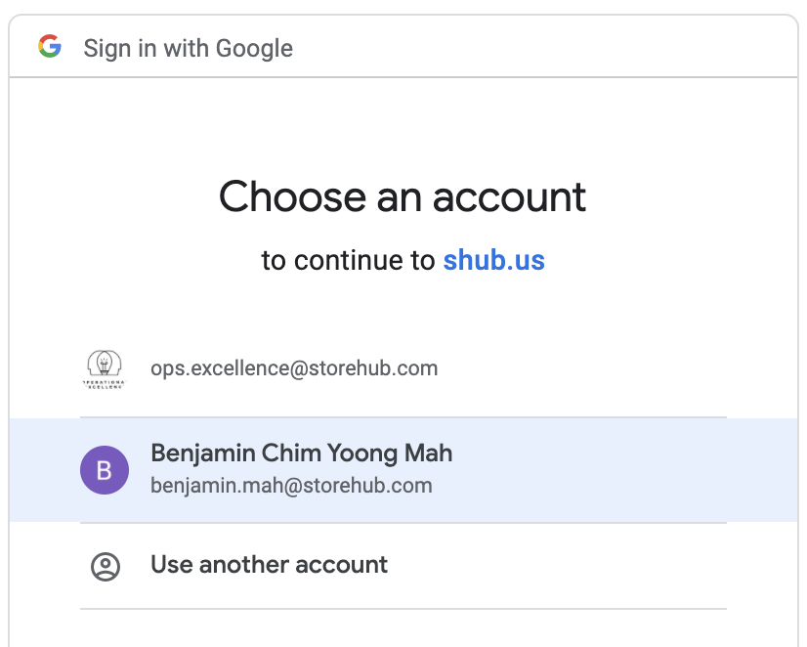
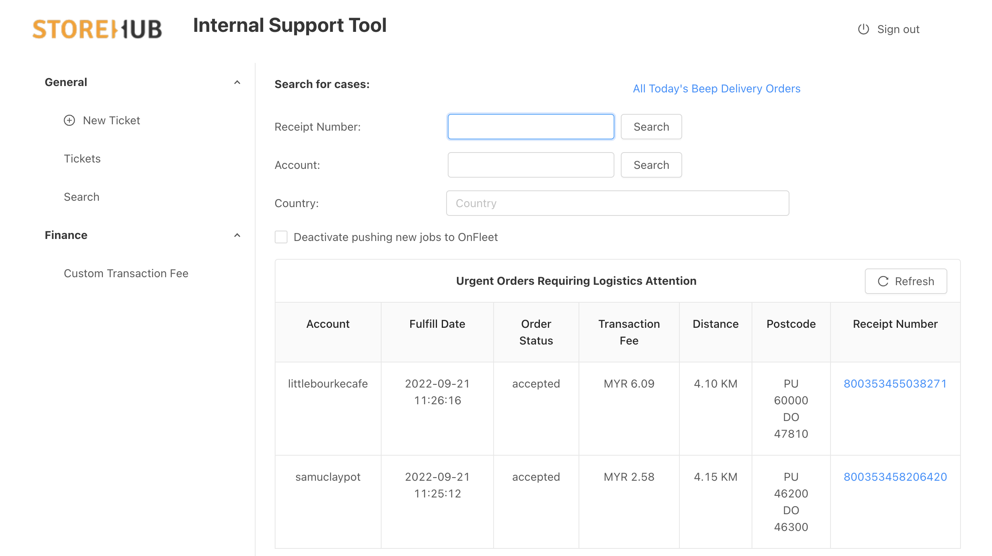
IST – Internal Support Tool
Internal
Support
Tool
Introduction
Functions
Links:
https://internal.shub.us/logistics/dashboard
Create Temp. Employee Access
Locating Beep orders
Payout adjustment
Sending vouchers
Mainly used by:
Beep Team
Logistics Team
Care Team

Slide 11
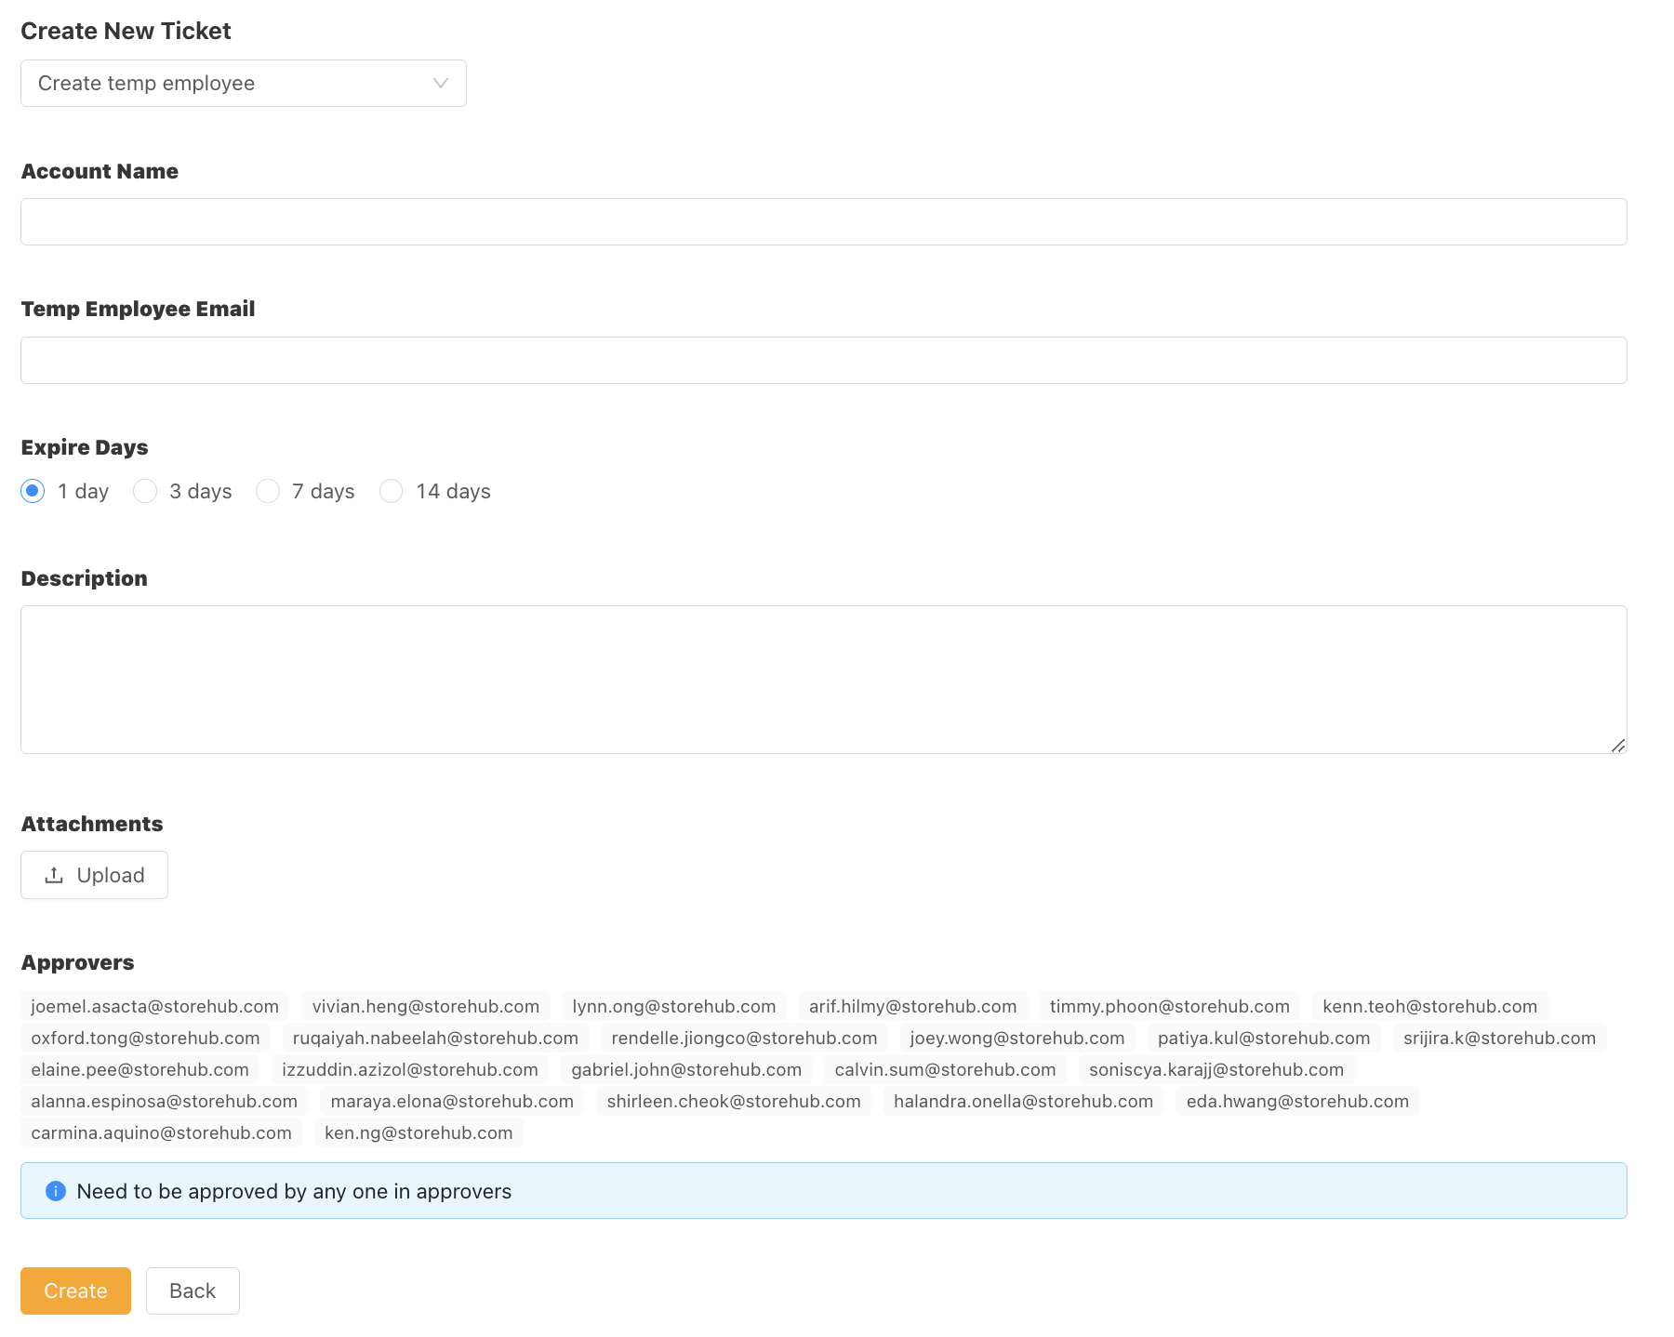
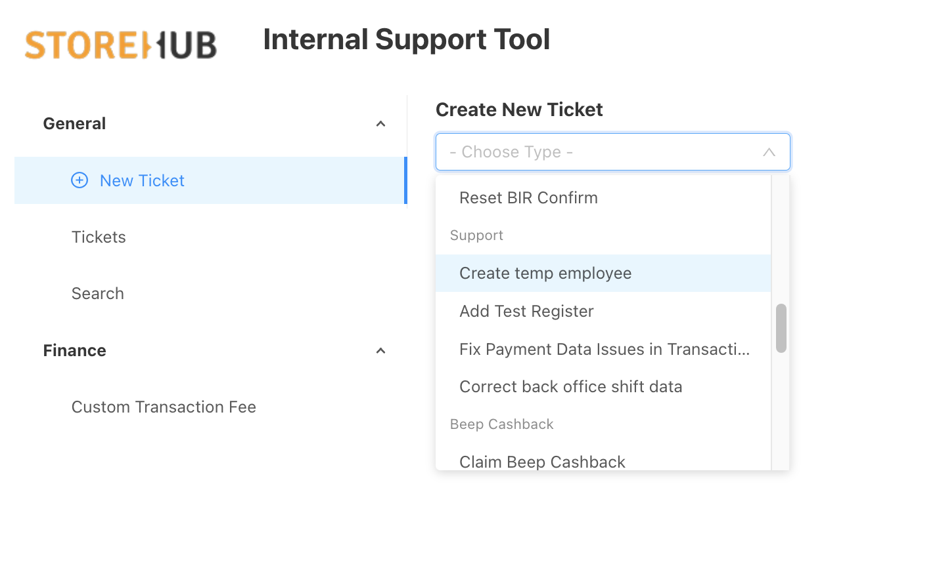
IST – Internal Support Tool
Internal
Support
Tool
Temporary Employee Access
Notes:
803907798012155

Slide 12
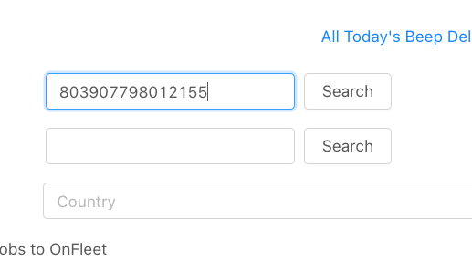
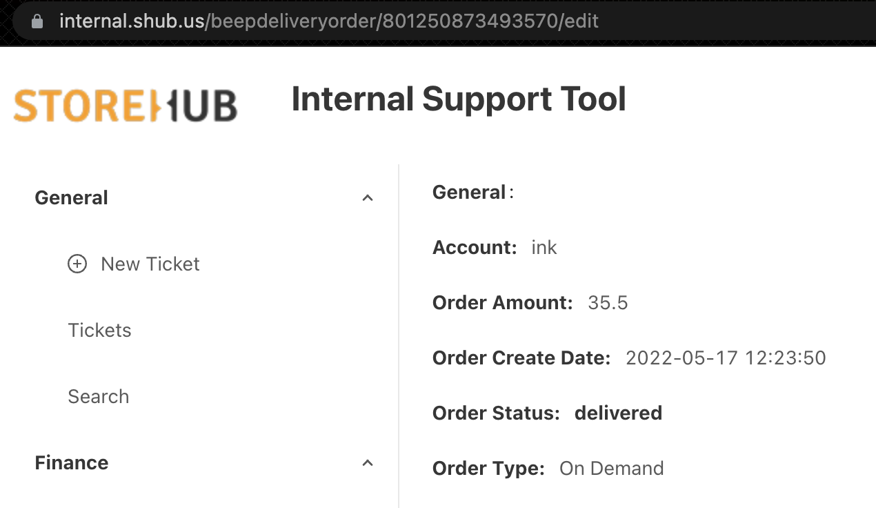
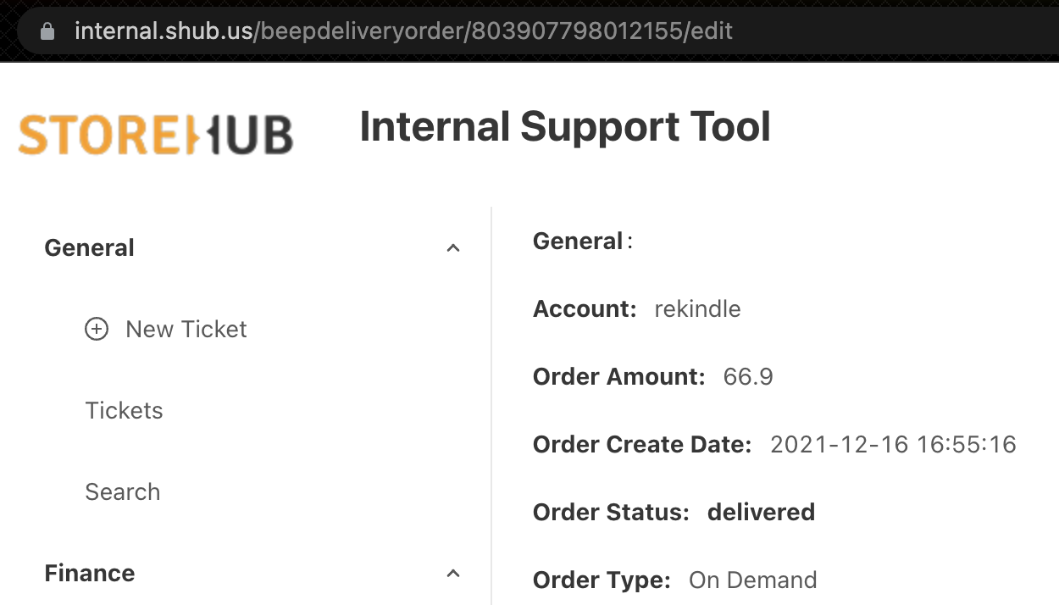
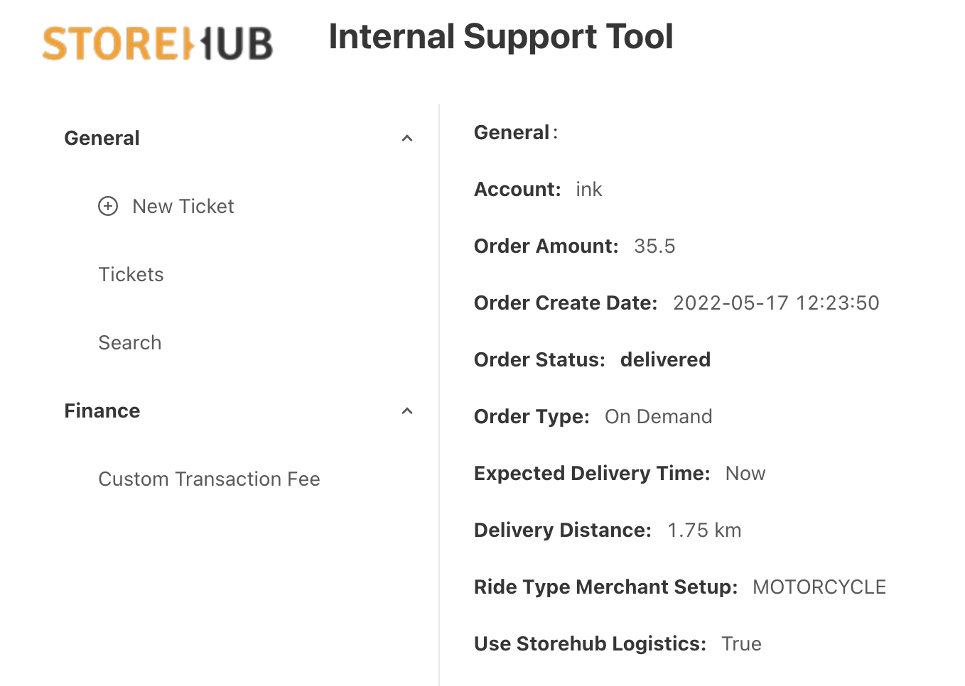
IST – Internal Support Tool
Internal
Support
Tool
Locating Beep Order
Method 1
Subsequent Option
Input receipt number
Change to different receipt number
https://internal.shub.us/beepdeliveryorder/803907798012155/edit
Notes:
803907798012155

Slide 13
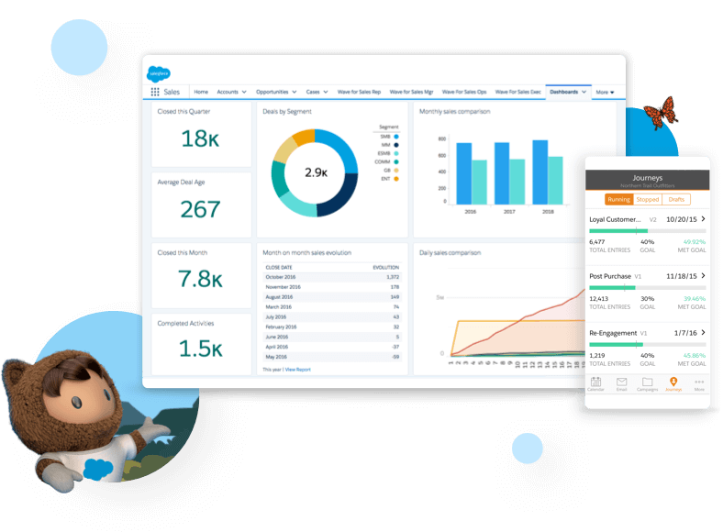

Salesforce
[ Team Using : Sales/Success/Care ]

Slide 14
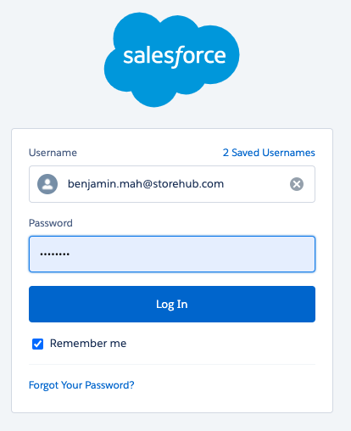
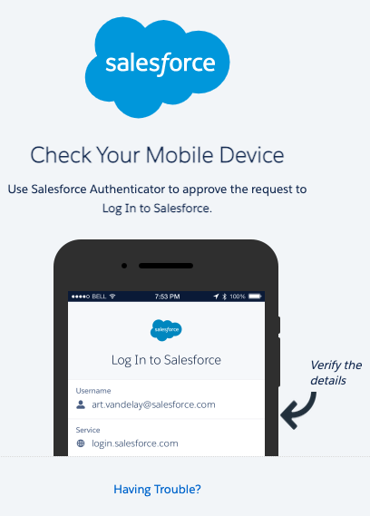
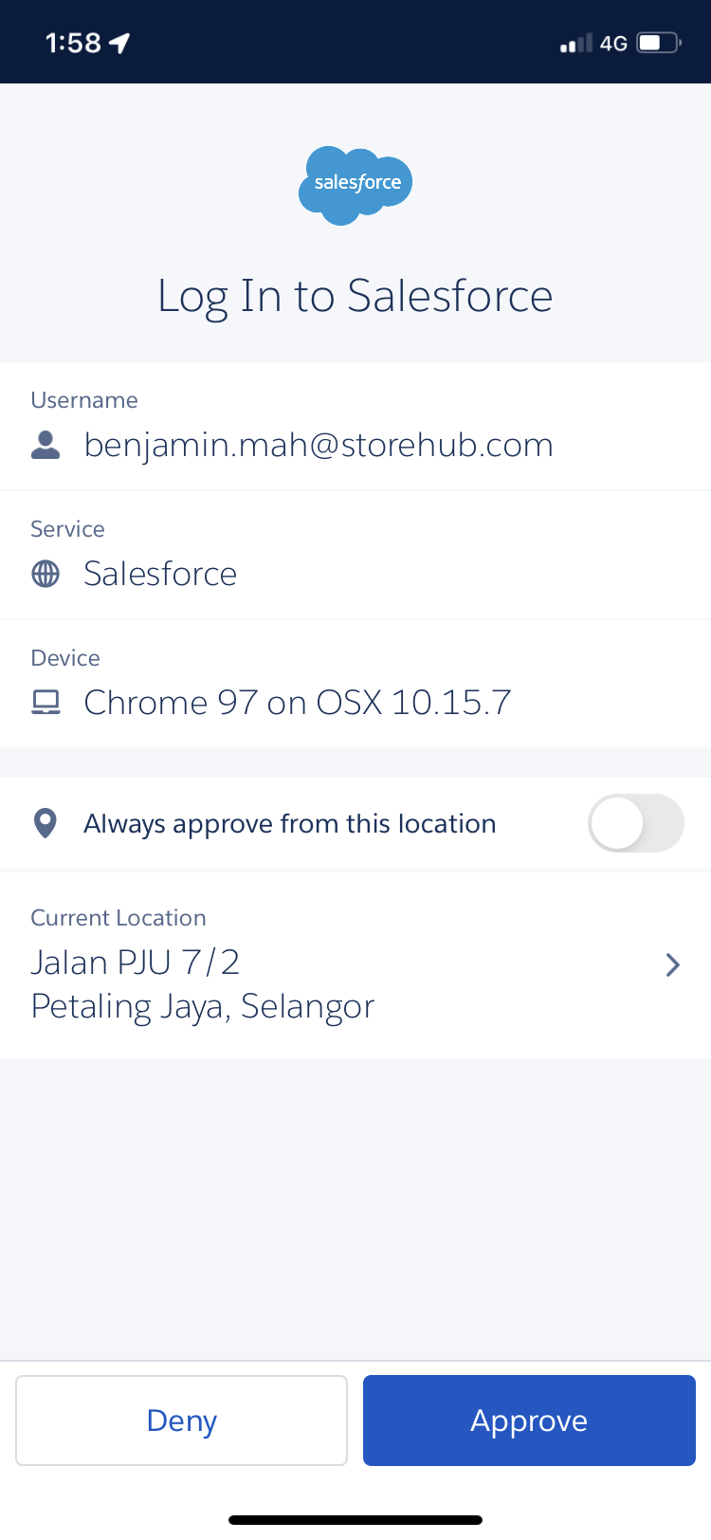
Salesforce
Login
https://storehub.my.salesforce.com/
Verify authentication by downloading Salesforce Authenticator app
Click approve on Authenticator app

Slide 15
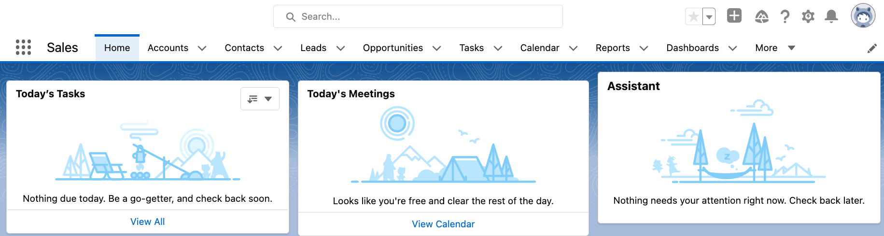
Salesforce
Introduction
Intro
Function
Used by
Managing merchant’s StoreHub journey
Lead > Won > Onboarding
Qualifying leads
Merchant’s information
Onboarding schedule
Hardware tracking
Sales Team
Success Team
Care Team

Slide 16
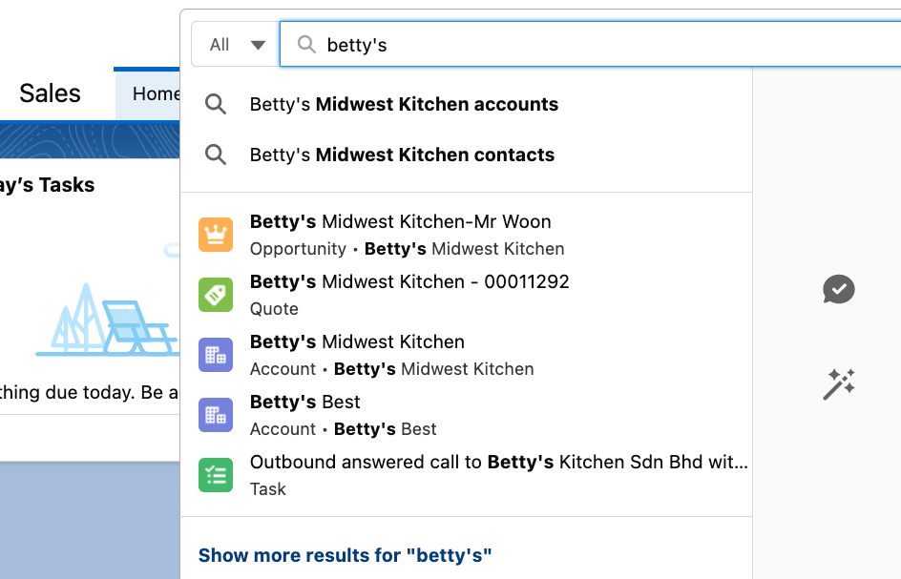
Salesforce
Navigation (cont.)
Search Input :
Account name
Email
PIC
Select Salesforce Objects:
Lead - New Lead (Qualified/Unqualified)
Opportunity - Meeting Completed by BC (Won/Lost)
Account - Overview of merchant’s Account Details
Contact - Merchant’s Contact Info
PIC = Person in Charge

Slide 17
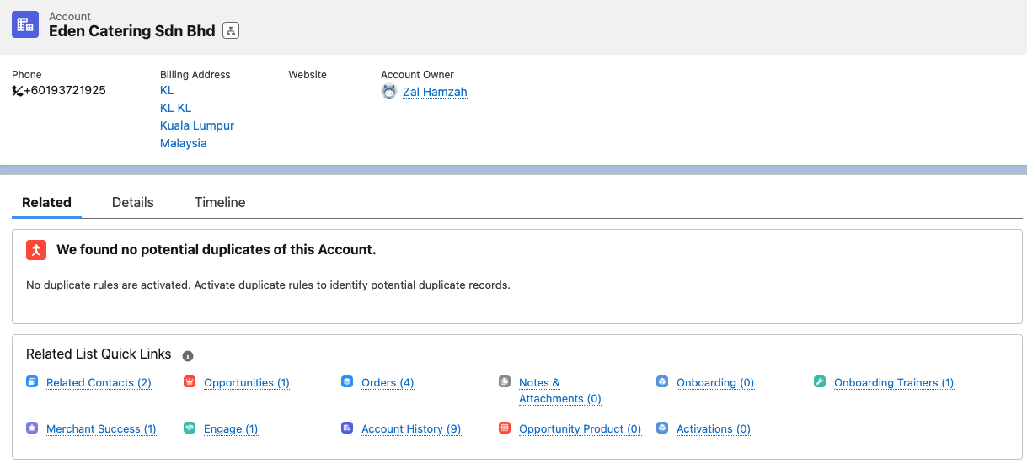
Salesforce
Navigation (Account)
Opportunities can be found under Account
Onboarding Pipeline
PIC = Person in Charge

Slide 18
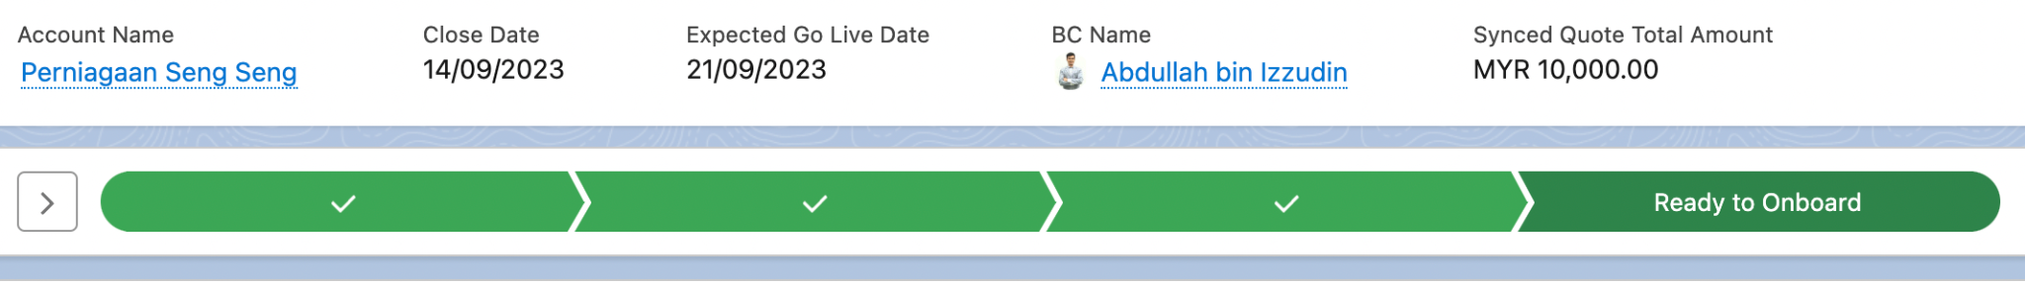
Salesforce
Navigation (Opportunity)
Paid Subscription: Account is still in the Sales pipeline.
Ready to Onboard: Already pushed to the Onboarding team to complete the checklist

Slide 19
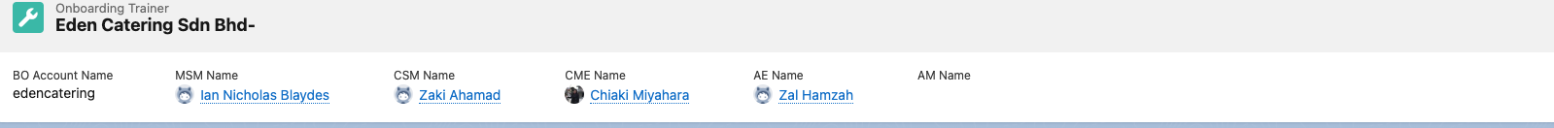
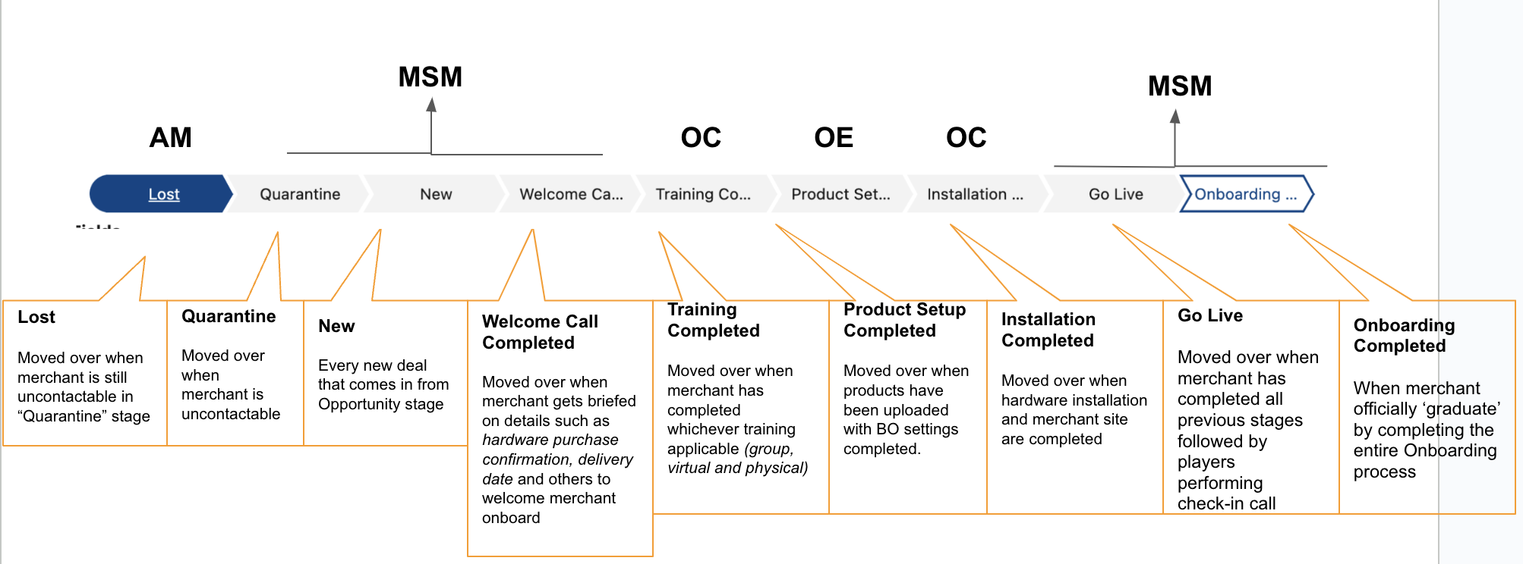
Salesforce
Navigation (Onboarding Trainers)
Name of Assigned:
CSM (Onboarding Consultant),
CME (Onboarding Executive)
Merchant Success Manager (MSM)
Business Consultant (BC)

Slide 20

[ Team Using : Account Management / Care ]

Slide 21
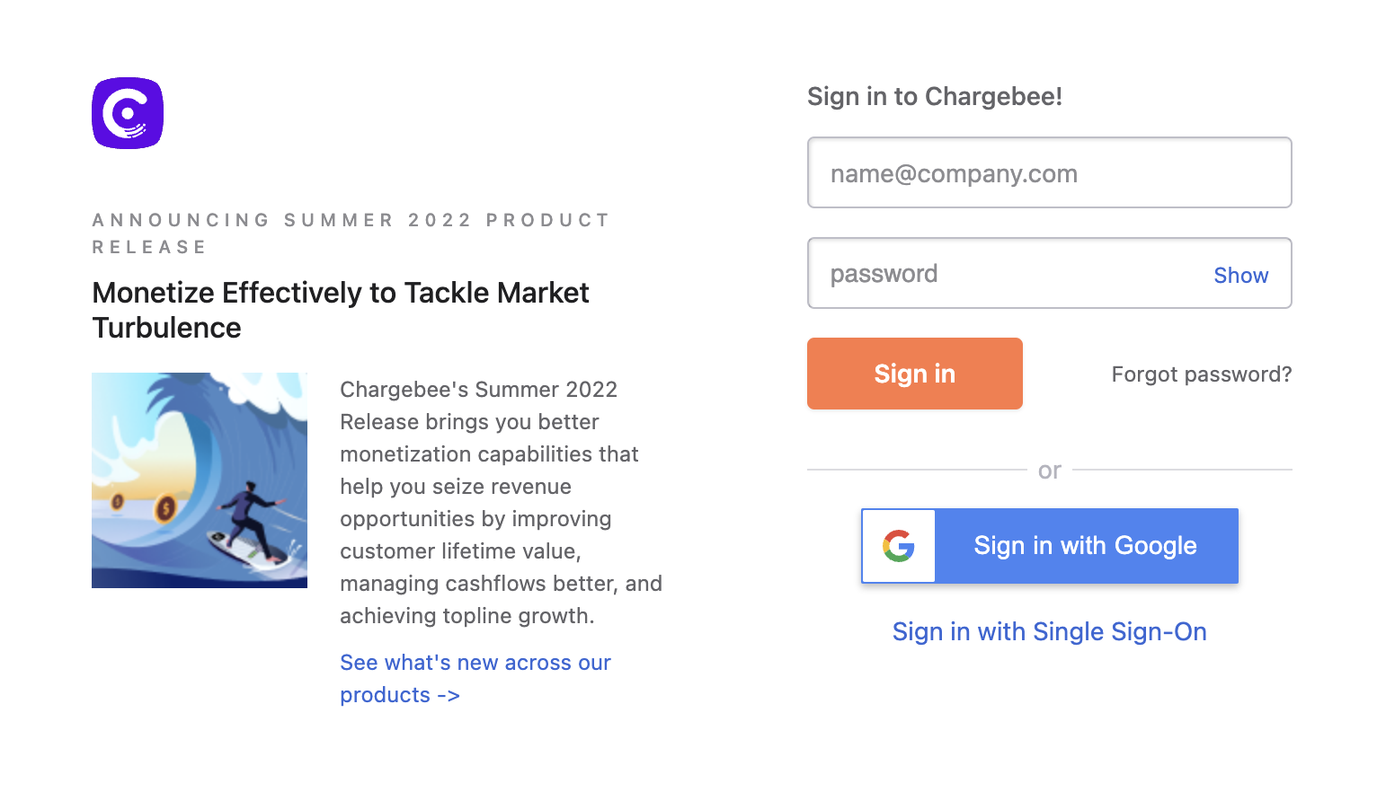
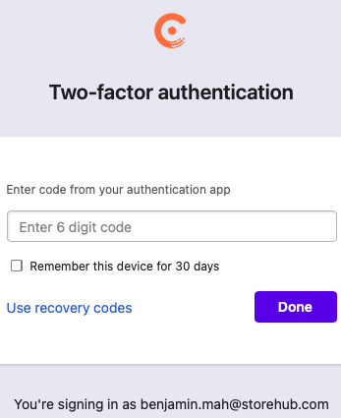
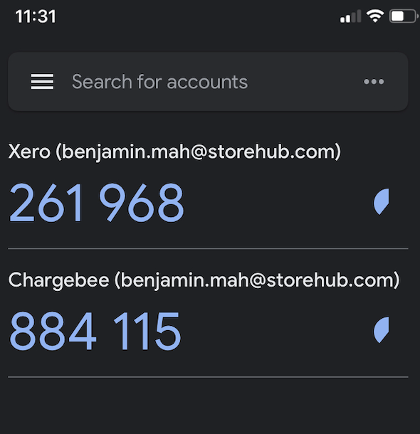
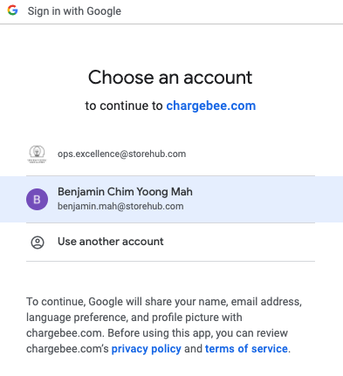
Chargebee
Login
https://app.chargebee.com/
Verify authentication by downloading Google Authenticator app
Once added, key in the same 6 digit code in the web page
Sign in with Google account
App = Application

Slide 22
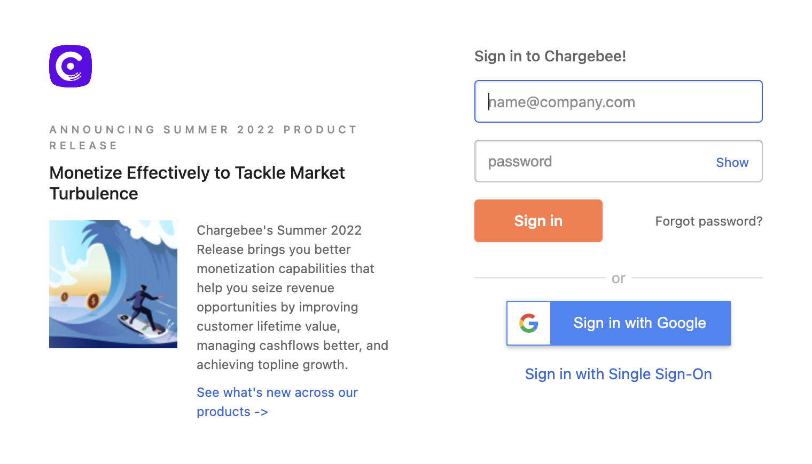
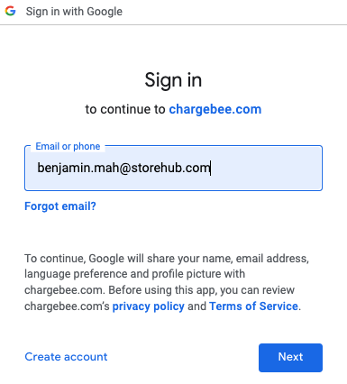
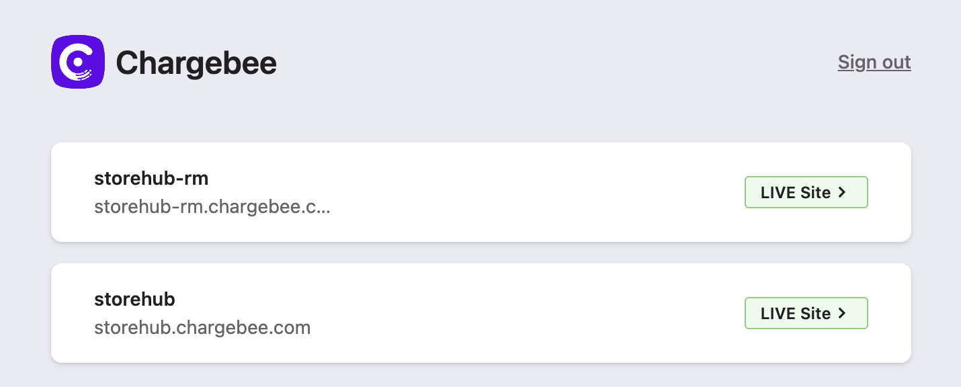
Chargebee
Introduction
https://app.chargebee.com/
Functions
View merchant’s subscription details
Edit merchant’s subscription
Mainly used by:
Account Management Team
Care Team
storehub-rm.chargebee.com
[Malaysian accounts only]
storehub.chargebee.com
[All accounts except Malaysian account]

Slide 23
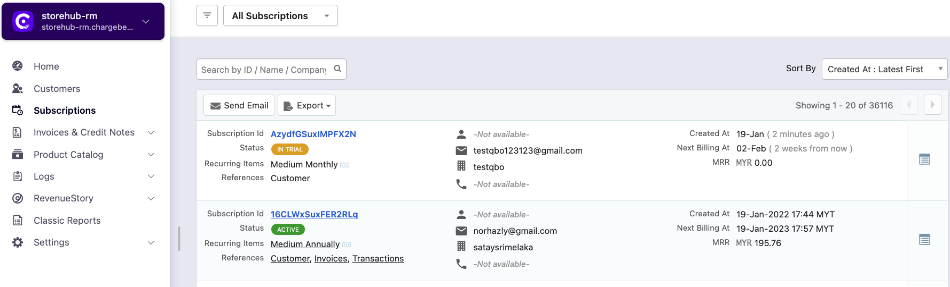
Chargebee
Navigation
Customers
Subscriptions
View contact information of merchant
Limited information on merchant subscription details
Merchant’s detailed subscription information
View charges and payment information of subscription

Slide 24
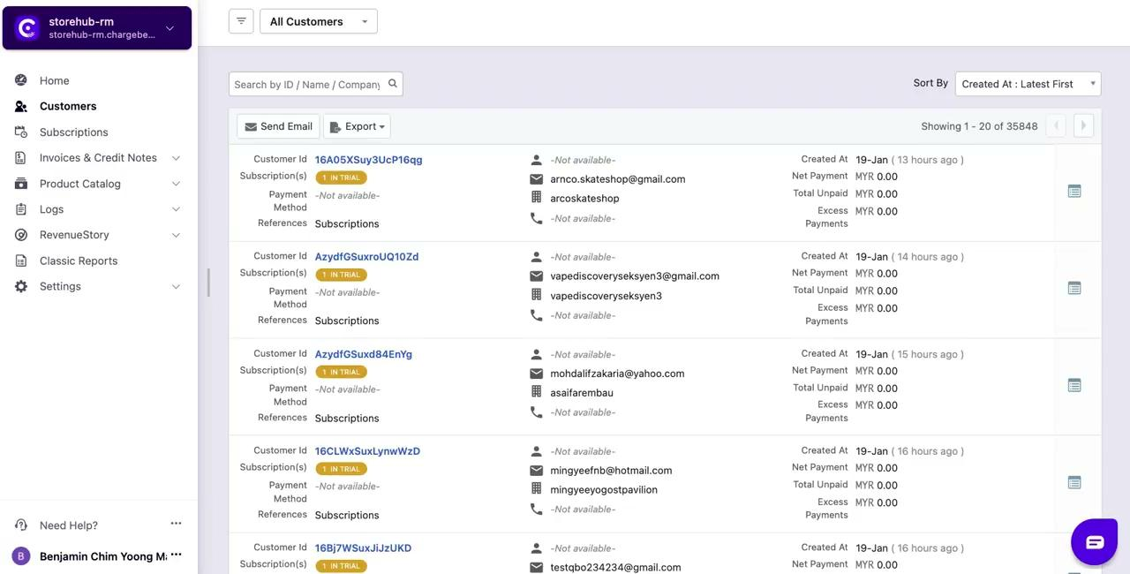
Chargebee
Navigation - Video

Slide 25
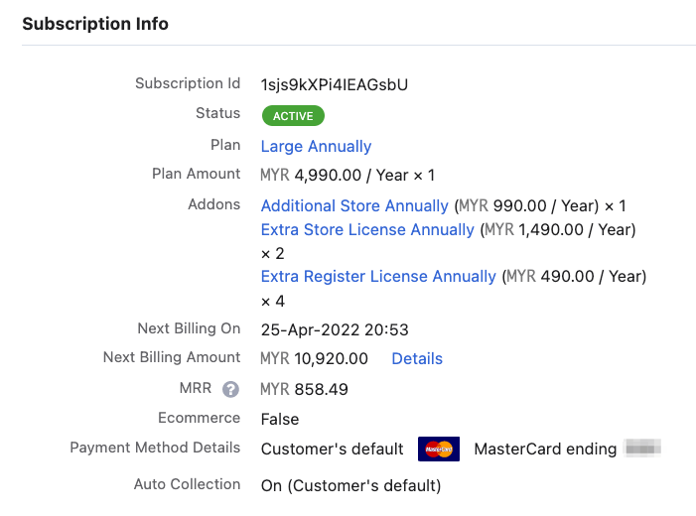
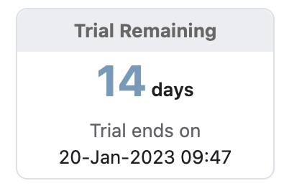



Chargebee
Subscription Details
Active
Merchant’s plan is still active
Cancelled
Merchant cancelled their plan
In Trial
Merchant recently register with StoreHub
Merchant Subscription Plan (Annually / Monthly)
Small: Starter Plan
Medium: Advance Plan
Large: Pro Plan
Base Plan: Base Plan
Additional Store [Extra store license]
Country | Pricing (Yearly)
 | MYR 1,490
 | PHP 490
 | THB 12,500
Additional Register [Extra POS terminal in existing store]
Country | Pricing (Yearly)
 | MYR 490
 | PHP 190
 | THB 6,000
SH = StoreHub

Slide 26
Chargebee
Subscription Details
Next Billing On
When will SH charge
Next Billing Amount
Total Charges
MRR
Monthly Recurring Revenue
Payment Method
Card: Auto charge / Auto debit
Blank: Manual payment
SH = StoreHub

Slide 27
Intercom & Aircall (Inbound Call)

Slide 28

System Flow
Flow
Call comes in
Existing User?
Yes
User details will be displayed
(Intercom Name, Role & Company)
Aircall
No
User displayed with only contact number
Assigned under respective team:
Malaysia: CX 🇲🇾MY Inbound Voice Team
Philippines: CX 🇵🇭PH Inbound Voice Team
Automatically creates a new user
Call logs into NEW and “Open” conversation
Intercom
Player record necessary summarised info in notes
Close conversation

Slide 29

​​
Process Flow
Inbound Call Process
Call comes in
Automated Message
Listen to Welcome Message, selects one of the IVR options
Option 1: Sales Enquiry
Option 2: Merchant & User Beep Support
Option 3: Merchant Point of Sales Assistance
Option 1
Inform caller about Call Recording Disclosure and to hold while getting connected to rep
Aircall connect call to sales number
Option 2
Inform caller about reaching out to StoreHub via LiveChat
End of call
Option 3
Inbound Users (Callers)
Inform caller about Call Recording Disclosure and to hold while getting connected to rep
Automated Message
Hearing Greeting Message - After 1 Min > 1st Idle Message - After 5 Mins > 2nd Idle Message - After 5 Mins > 3rd Idle Message > End Call
Sequence will stop upon call answered by player
Available player?
No
Available player?
Yes
Yes
Refer to the next slide
IVR = Interactive Voice Response

Slide 30
​​
Process Flow
Inbound Call Process (cont.)
Pick up call, greet & obtain caller BackOffice Name
Depending on the inquiry, perform one of the three actions on Intercom:
Beep Merchant or User Inquiry: Direct user to reach out to StoreHub BackOffice/ Beep App Live Chat
Sales Related Inquiry (NEW lead): Here Fills up detail (user name, phone#, company name & email), submit lead form, then informs merchant to expect callback within 1 working day
Other Department Inquiry: Create new ticket, escalate ticket to relevant department and inform merchant to expect contact within 2 working days. (E.G: Account Management, Activation, Onboarding)
Summarise note on Intercom conversation using Call Summary (Internal Notes) macro and select appropriate Call Outcome (FCR) option
Within Scope?
No
Inbound Care Players
Yes
Address merchant's POS related issues & queries
Refer to the next slide
End of call
FCR = First Contact Resolution

Slide 31
​​
Process Flow
Inbound Call Process (cont.)
Depending on the inquiry, perform one of the three actions on Intercom:
Hardware/Software/Mall Integration Escalation: Escalate ticket to tier 2 by using L2 Hardware Support/ L2 Software Support/ L2 Mall Integration ticket type
User Follow Up Callback Request: Obtain customer email and create a new ticket using L1 Outbound Call Form ticket type
Other Department Inquiry: Create new ticket, escalate ticket to relevant department and inform merchant to expect contact within 2 working days.
Address merchant's POS related issues & queries
No
Further
Assistance
Required?
No
Yes
Inbound Care Players
Issue Resolved?
Summarise note on Intercom conversation using Inbound Call Summary (Internal Note) macro and select appropriate Call Outcome (FCR) option
Yes
Put user on hold and refer to Team Lead
End of call

Slide 32
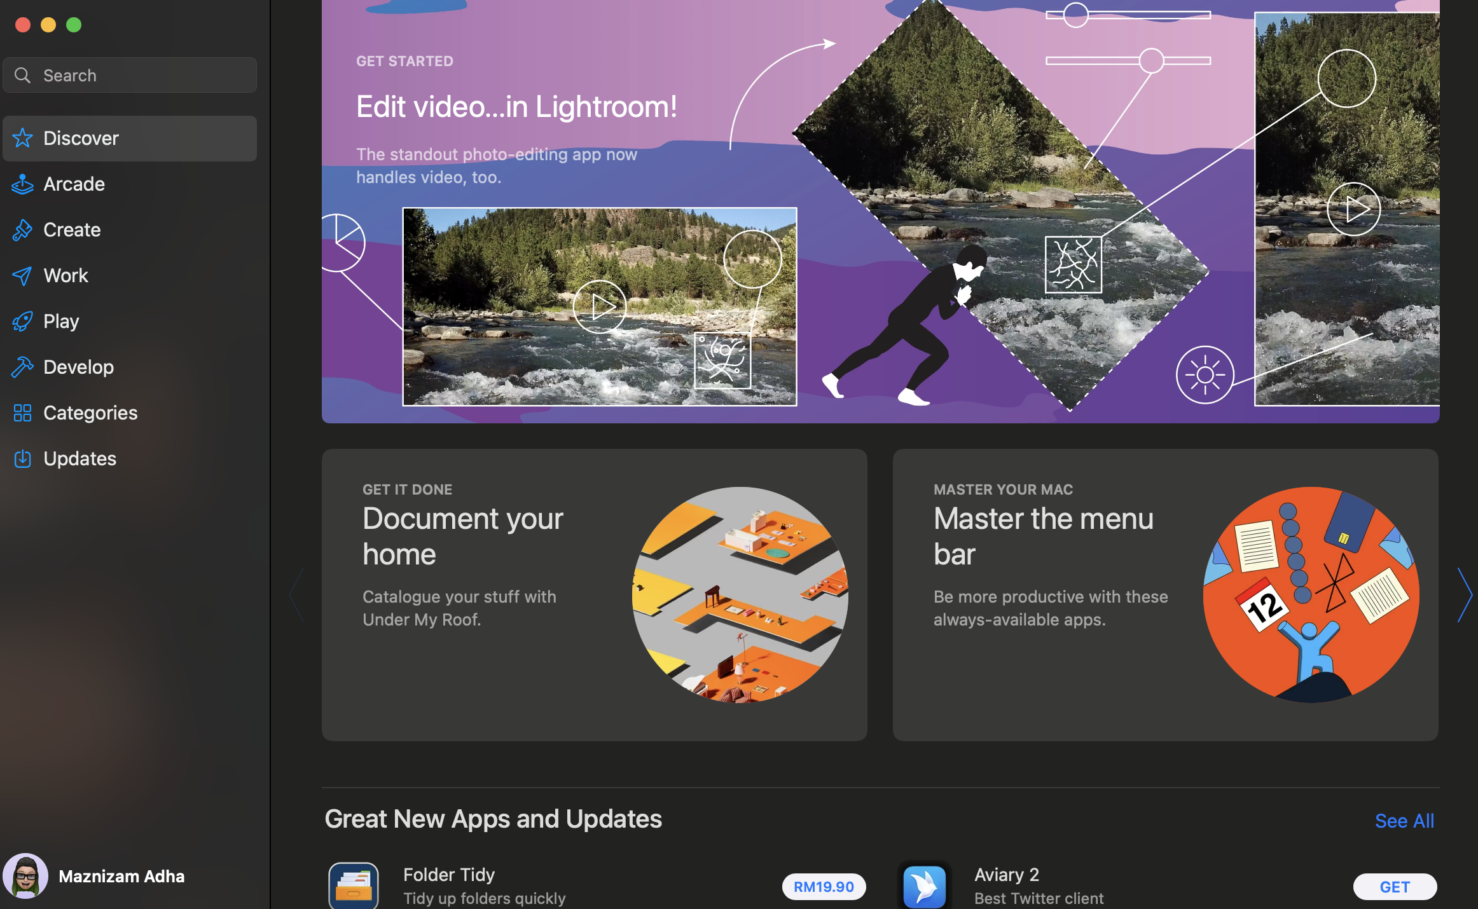


Aircall
Download Aircall
Open Apple Apps Store on your Macbook
Search “Aircall” on the search bar

Slide 33
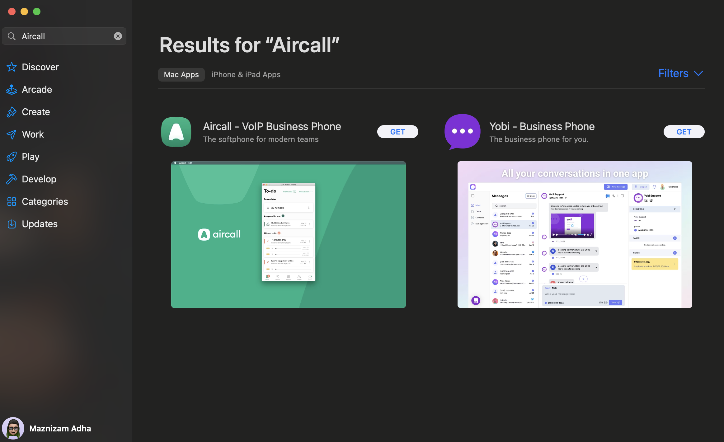
Aircall
Download Aircall (cont.)
Click “GET” to download Aircall on your Macbook

Slide 34
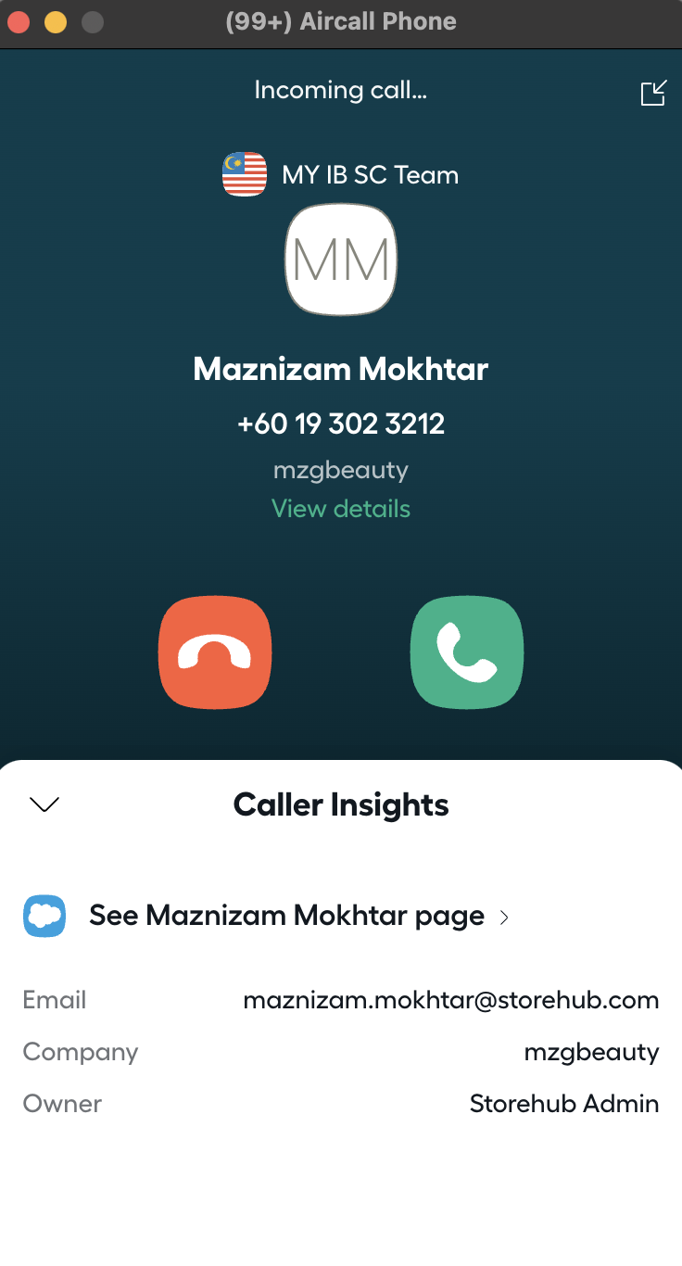
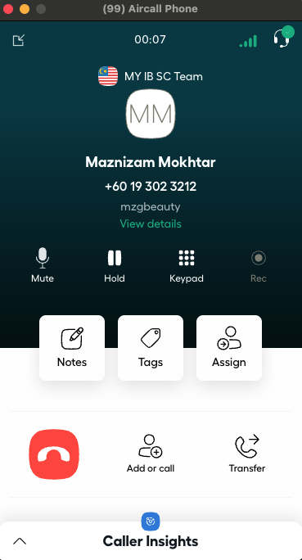
Aircall
Inbound Call
Button | Function
 | Mute agent’s microphone
 | Put customer on hold
 | Input Number
 | Adding notes for your call (synced to Intercom conversation)
 | Categorize your call activity for reporting
 | Assign your teammate for follow up
 | Consult or Conference call
 | Transfer call to other player
 | End call
Contact details will be available
You may use phone functionality during call

Slide 35
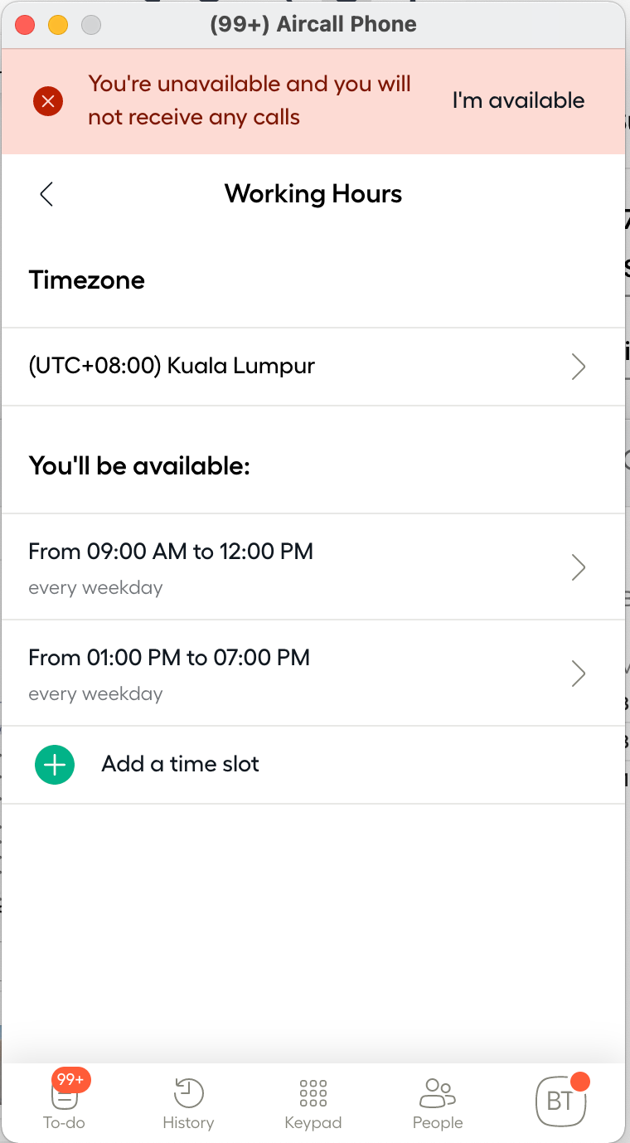
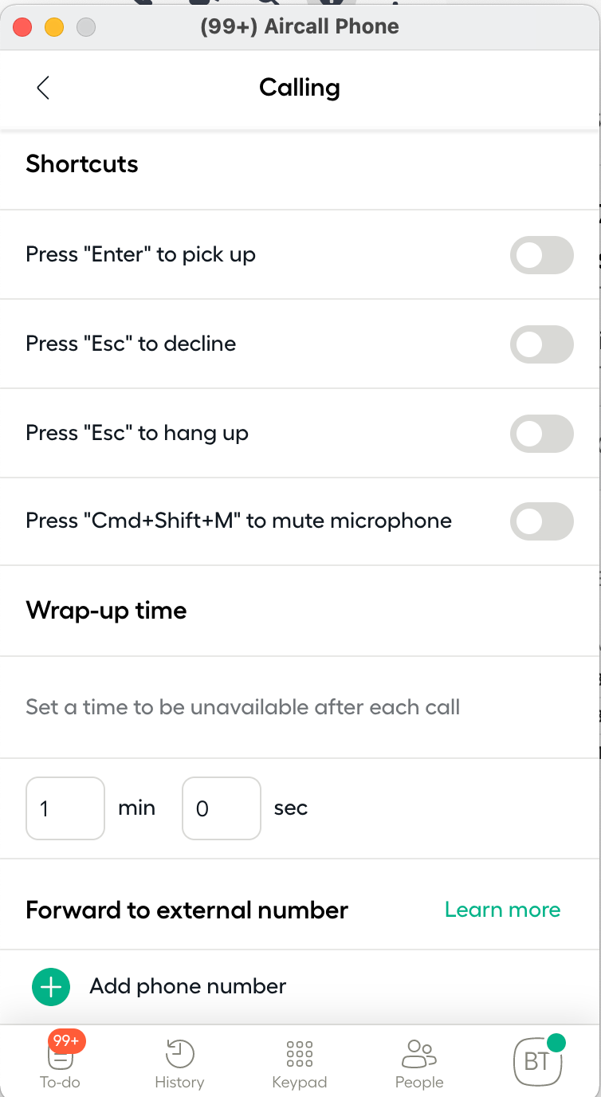
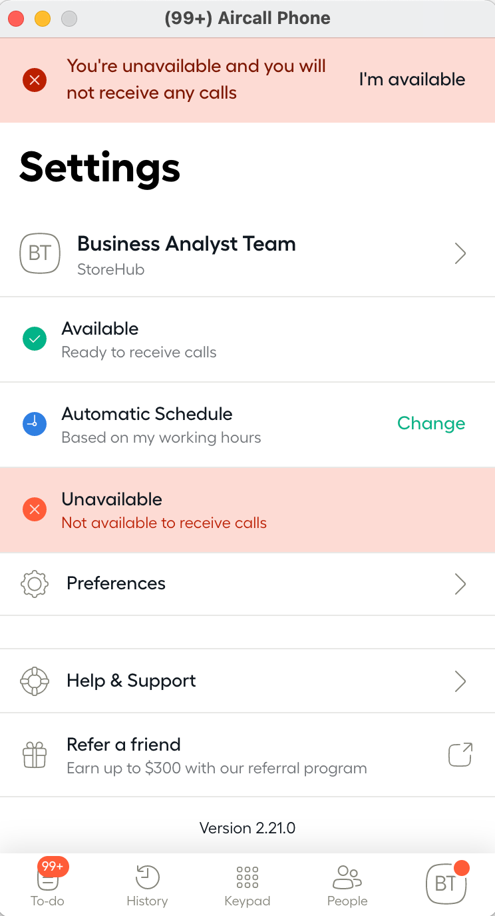
Aircall
Agents Don'ts
Do NOT change working hours.
It should always stay 9am - 6pm, (Unless told otherwise)
Do NOT change Wrap-up time, It should always stay 1 min
(Unless told otherwise)
Do NOT change status to “Unavailable” unless going for break, meal or TL consultation. Request permission from TL before doing so

Slide 36
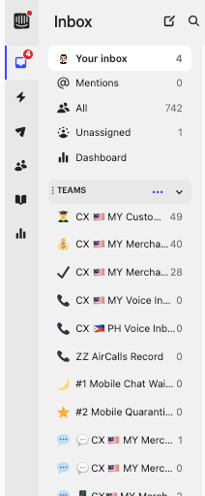
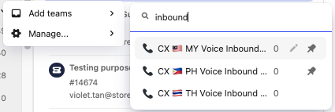
Intercom
Team Search
When to use?
When agents wish to locate team and retrieve conversations
Team Search
Hover cursor over to reveal “pen” button and click on it
Type and search for “CX 🇲🇾 MY Voice Inbound Team”

Slide 37
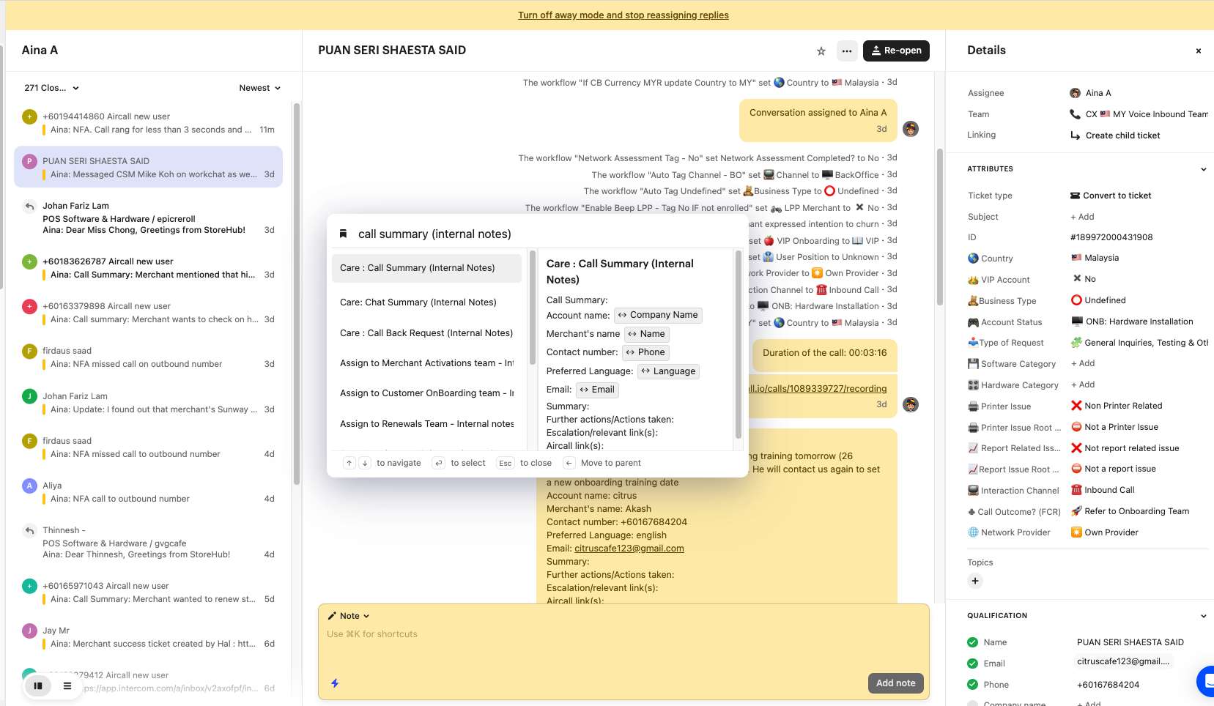
Intercom
Conversation Creation & Macro Usage
Intercom Conversation
Automatically created after receiving inbound call from Aircall
Macro Usage
Player to use “Call Summary (Internal Notes) ” macro and fill up details accordingly

Slide 38
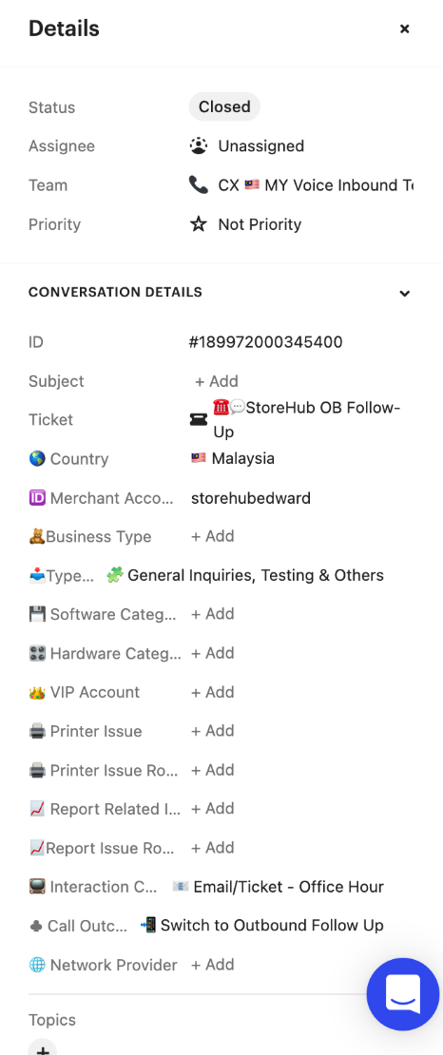

Intercom
Call Outcome (FCR) Selection
Call Outcome (FCR)
Need to be completed after call has ended
Tag as per case resolution status
FCR = First Contact Resolution

Slide 39

Intercom
Close Conversation
Important Notes
Close the conversation when the issue is resolved/no follow up/no reply is required
Fill up required information before closing the conversation

Slide 40

Video
Call Flow (Video)
Aircall
Intercom

Slide 41
Intercom (Email)

Slide 42




Email
Creating Outbound Email
1
2
Steps
Create a new box conversation
Select “Conversation”.
Select “Email”.
The default email address is always from care@storehub.com
Fill in Subject > Type in the content > Send
3
4
5

Slide 43


Email
Handling Inbound Email
Email is auto assigned to player
Player unable to choose their customer
Email Layout

Slide 44




Email
Reply vs. Note
Reply
Player reply to customer tickets by adding contents
Internal Note
Player leave internal note for the case (It is not visible to merchant / customer view)

Slide 45




Email
Macro
Methods 1: How to use Macro
Type “#” at the Reply Box
Select the correct macro on the popup box
Player need to check and edit the macro before sending out to customer

Slide 46

Email
Macro (cont.)
Methods 2: How to use Macro
Click ”...” icon
Select the correct macro on the popup box
Player need to check the macro before sending out to customer

Slide 47
Intercom (Live Chat)

Slide 48



Chat
Outbound Bot Message
Care Team
Send disclaimer to merchant to notify chat will be recorded for Training & Quality Assurance purposes
Informed on the accessibility to merchant’s BackOffice
Provide relevant KB articles for merchant’s reference
1
2
3
KB = Knowledge Base

Slide 49

Chat
Handling Inbound Chat
Live chat is auto assigned to player
Player unable to choose their live chat
Live Chat Layout

Slide 50


Chat
Reply vs. Note
Reply
Player reply to customer ticket by adding contents
Note
Player leave internal note for the case / summarise the case to relevant department (It is not visible to merchant / customer view)

Slide 51



Chat
Macro
Methods 1: How to use Macro
Type “#” at the Reply Box
Select the correct macro on the popup box
Player need to check and edit the macro before sending out to customer

Slide 52



Chat
Macro (cont.)
Methods 2: How to use Macro
Click ”Bookmark” icon
Select the correct macro on the popup box
Player need to check and edit the macro before sending out to customer

Slide 53




Chat
Tagging for Chat
1
Required Details before Closing Conversation
Case Resolved (FCR)
Accepted CCT
Merchant Account Name
Printer Issue
Printer Issue Root Cause
Report Related Issue
Report Issue Root Cause
Type Of Request
2
3
4
5
6
7
8
Close Conversation Button
FCR = First Contact Resolution

Slide 54



Chat
Tagging for Chat (cont.)
Merchant Account Name
Key in manually as per Chargebee subscription.
You will be able to locate Company Name from User Data
Alternatively, the Account Name can be found from the beginning of the conversation which filtered by the AutoBot
Type of Request
Tag as per Merchant’s type of request/inquiry

Slide 55


Chat
Tagging for Chat (cont.)
Printer Issue
Tag is required if it is regarding to printer issue
Notes: If it’s not printer issue, select
“X Non Printer Related”
Printer Issue Root Cause
Tag is required for the printer issue root cause, if any.
Notes: If it is not printer issue, select
“Not a Printer Issue”

Slide 56



Chat
Tagging for Chat (cont.)
Report Related Issue
Tag is required if it is regarding to printer issue
Notes: If it’s not printer issue, select
“X Not report related issue”
Report Issue Root Cause
Tag is required for the report issue root cause, if any.
Notes: If it is not printer issue, select
“Not a report issue”

Slide 57


Chat
Tagging for Chat (cont.)
Case Resolved?FCR
Tag as per case resolution status
Notes: This tagging is based on the status of the end conversation.

Slide 58
Chat
Close Conversation
Important Notes
In order to close the conversation, tagging on all required details (attributes) is a MUST.

Slide 59

Basic Functions

Slide 60

Basic Functions
Assign to Team / Teammate
Important Notes (Care)
Inbound Ticket / Chat / Email will be assigned to Care players automatically through round robin.
If reassignment is required, it can be assign / transfer to specific team / member. Make sure to select correct team / member.

Slide 61



Basic Functions
Assign to Team / Teammate
Assign to Teammate
Manually assign a conversation to a specific teammate, the team assignment also remains in place
Assign to Team
Assigning a conversation to a team will remove the teammate assignment, so it can be picked up from that team’s inbox at the right time

Slide 62


Basic Functions
Snooze Conversation
Important Notes
If follow up is required, player can opt to snooze the conversation and set specific time.
It will reopen automatically when set specific time ends.
Player need to reply the conversation within the promised time given to the merchant / consumer.

Slide 63


Basic Functions
VIP Queue
VIP Live Chat
VIP Ticket
Important Notes:
VIP inboxes are set up for VIP merchants to be prioritised when they reach out to Merchant Care team
VIP chats will be assigned to available players as priority (Unless player’s chat pool is full (Max. 5 chats)
VIP – Very Important Person

Slide 64


Basic Functions
Ticket Escalation (Create New Ticket)
Ticket Creation
Select the relevant ticket to be created
When to use?
When issue requires other team (Renewal, Onboarding, Activation) to follow up. Inform merchant to expect contact within 2 working days. (E.G: Renewal, Activation, Onboarding)
OB = Outbound

Slide 65

Basic Functions
Ticket Escalation (Cont.)
Care Inbound Call & Live Chat team to use for scheduled follow up outbound call to merchant
Escalation from Care T1 > MSM for Beep QR & Delivery Leads
Escalation from Care T1 > MSM for Food Delivery Integration requests
Escalation from Other department > Care T1 for Hardware/Software/BackOffice troubleshooting requests
Escalation from Care T1 > T2 for Hardware related issues
Escalation from Care T1 > T2 for Mall Integration related issues
Escalation from Care T1 > T2 for software related issues
Tickets Type to Success: Click here for more details
Escalation from Care > Onboarding/Account Management for account/onboarding related requests
OB = Outbound

Slide 66



Basic Functions
New user Lead Submission
When caller gets connected through with Care players but require sales inquiry
Notes:
Important note: Phone number MUST be added with correct country code “+60” & “+63” to standardize mapping between SF and Intercom

Slide 67


Basic Functions
AI Assist
AI Assist
Can help to:
Rephrase sentence
Make it more formal
Make it more casual
FCR = First Contact Resolution

Slide 68

Basic Functions
AI Assist (Video)
FCR = First Contact Resolution

Slide 69


Supply Chain
[ Team Using : Supply / Care ]

Slide 70




Supply Chain
Overview
Introduction
Salesforce
Oracle Netsuite
Delivery Issue

Slide 71


Supply Chain
Introduction
Look out for latest announcements on updates related to:
Supply Chain: Hardware related updates
Scan and join the group to stay updated with announcement!

Slide 72






Supply Chain
Introduction
Vendors Used

Slide 73

Supply Chain
Oracle Netsuite
Dashboard

Slide 74
Supply Chain
Quotation & Order Creation
Salesforce
Netsuite
Create Quote
Email Quote & follow up payment
Create Order
Attach Payment Slip
Sales / Success
Approve and activate order
Sync into Netsuite Sales Order
Finance
Update Netsuite Memo as Software / Hardware / Software + Hardware
Close SO
Generate invoice and send to merchant
Process SO & Arrange Hardware Delivery.
The delivery details (tracking link or number) will be synced into SF through integration on daily basis (Salesforce x Vendor Gsheet Integration)
Supply Chain
SO = Sales Order

Slide 75


Supply Chain
Tracking Number in Salesforce
Use Salesforce to search for Supply Chain information such as
Transport Type
Tracking Number / Tracking Link
Delivery Status & Timestamp
SalesForce order dashboard - Here

Slide 76
Supply Chain
Hardware Delivery
Hardware Delivery SLA
Within Klang Valley: Delivery Provider: Lalamove (Default) Same day between 3.00pm - 5.00pm | Outside Klang Valley: Delivery Provider: GDEX Peninsular: Between 3 - 5 days East Malaysia: Between 5 - 7 days
Onsite Service SLA
Case / Ticket creation in Tracking: Cut-off time is 12.00pm daily Tier 2 will contact merchant within 1-2 working days to arrange for visit.
State | Portal Request Date (by StoreHub) | Appointment Contact Day By Engineer (working day) | Target Engineer Appointment Date (Depending on agreed Date)
Selangor / KL | Wednesday before 12.00pm | Thursday (next day) | Friday
 | Wednesday after 12.00pm | Friday (day after next) | Monday
Kelantan / Terengganu / Kedah (Weekend: Friday & Saturday) | Wednesday before 12.00pm | Thursday (next day) | Sunday
 | Wednesday after 12.00pm | Sunday (day after next) | Monday
SLA = Service Level Agreement

Slide 77

Supply Chain
Escalation Flow for Hardware Delivery
Merchant’s Responsibility:
Check all items delivered
Check physical condition of goods delivered
Take clear picture of parcel / item if damaged
Malaysia
Damaged Parcel / Missing Item | Defective Unit
Within 1 working day of receiving Parcel | Within 14 days of receiving parcel
Contact Salesperson/ Success:
Raise ticket to Supply Chain by sending email to care@storehub.com
Contact Merchant Care Team:
Merchant Care team to raise internal note with @businesssupport
SurfsTek & iMin MAY NOT entertain if report is given past 3 working days
If there are any issues, Merchant to take all the evidence, keep all original packaging and content for the reverse pick-up.

Slide 78

Thank you!
The End
THIS DOCUMENT IS STRICTLY PRIVATE AND CONFIDENTIAL. THIS IS INTENDED FOR INTERNAL USE ONLY; DO NOT CIRCULATE
Copyright © 2022 StoreHub. All rights reserved. No parts of this document can be reproduced, distributed, transmitted or stored electronically without StoreHub’s prior written permission.
21

